Slide 1
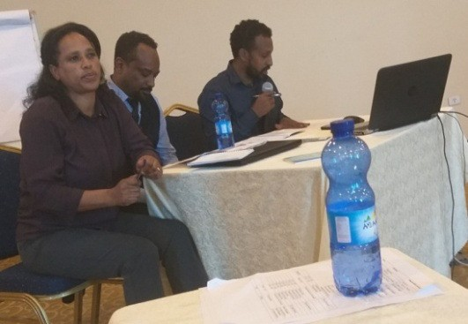
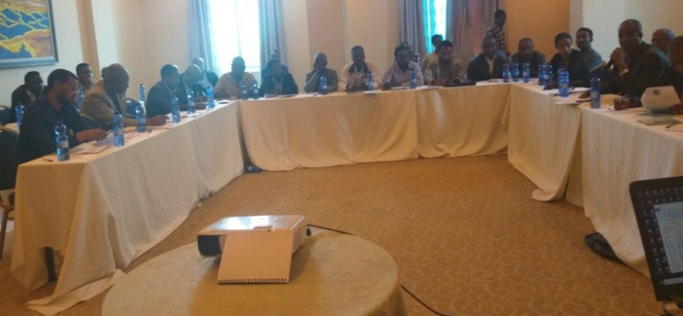
Quality Tree Seed Provision System Establishment through Tree Seed Networking in Ethiopia (ጥራት ያለው የዛፍ ዘር አቅርቦትን ለማሳደግ የዛፍ ዘር አጋር አካላት ትስስር መመስረትና ማጠናከር)
Yigardu Mulatu ¹, Teshome Tamirat ², Fasika Bekele ² and Mohammed Adefa³
¹ EEEFRI HQ, ² EFCCC, ³Central Ethiopia Environment and Forest Research Center
Introduction
Currently, tree seed demand of the Ethiopia is fulfilled through provision of seeds of different qualities by different public and private organizations and the informal seed suppliers in the country. Maintaining quality and bridging information gap between suppliers and buyers is found deemed essential. Thus establishing a Tree Seed Network (TSN) was initiated by the joint discussion between the Environment, Forest and Climate Change Commission (EFCCC), the Ethiopian Environment and Forest Research Institute (EEFRI) and the ICRAF project - Provision of Adequate Tree Seed Portfolios in Ethiopia (PATSPO). TSN is established in 23-24 May 2019 by the joint facilitation of the three organizations (Figure 1). TSN members (40 participants) have set Terms of Reference (ToR) of the network that includes its mandates and functions.
Afterwards, TSN has hold its second national consultative meeting on 19 December 2019, six months after its establishment. TSN members identified main challenges and set directions and roles of stakeholders (Figure 2) in line with its objectives. It also established an online platform of communication on Google Drive, https://drive. google.com/drive/folders/1OanneJzYxx-dsMrBuMx5Nqx9Mho1KOV6 , for the moment, and is sharing information amongst member stakeholders.
Stakeholder (TSN member)
Assigned role to play
EFCCC + EEFRI
Jointly coordinate and lead the TSN
TSN members:
Forest Sector Development Program
Regional Bureaus of Environment and Forest Extension, Forest Authorities
Regional Offices of Agriculture
MoA (SLMP, Variety release Directorate, Natural Resources Directorate)
Addis Ababa City Administration
Dire Dawa city Administration
Forest/Agricultural Research Institutes
Public Forest (and Wildlife) Enterprises
Private Forest Seed Suppliers/Enterprises
The informal Seed Suppliers (sample representatives)
The Public Procurement and Property Administration Agency
Ethiopian Standards Agency (ESA)
Funding Organizations (ICRAF, GIZ, FAO, UNDP, etc)
Ethiopia Biodiversity Institute (EBI)
Agricultural Input and Seed Quality Control Authority of Amhara Region
Identified directions during the 2nd consultative workshop (19 December 2019): https://drive.google.com
/drive/folders/1OanneJzYxx-dsMrBuMx5Nqx9Mho1KOV6
Aware seed buyers/ users on the importance of using quality tree seeds
Facilitate timely release and flow of information on seed balance between tree seed suppliers and buyers
Facilitate preparation and implementation of meri - based tree seed bids that consider quality as primary basis (circular letters to the concerned),
Resolve issues of VAT vs. quality seed; quality vs. price, quality tested seeds/standards vs. price
Facilitate engagement of informal seed suppliers to join the formal seed suppliers’ group
Facilitate approval of the Tree Seed Proclamation and development of detail guidelines for implementation (legal basis)
Facilitate revision of tree seed quality standards based on practical technical problems encountered during implementation
Facilitate research on seeds that have problems
Update tree seed suppliers’ list
Facilitate provision of seed quality testing service to run with due care starting from sampling
Facilitate tree seed source mapping and registration
Sharing practical experiences among tree seed network members
Objective of the Tree Seed Network
The overall objective of the Tree Seed Network is to facilitate adequate provision of quality tree seeds of required species to all parts of the country by developing effective tree seed systems and facilitating networking among seed producers and users ,thereby enhance implementation of CRGE strategy of the country.
Figure 1፡ Establishment of the national Tree Teed Network, 24 May 2019, in the presence of stakeholders, Nexus hotel Addis Ababa
Figure 2: How the TSN operates፡ stakeholders, identified directions and responsibilities
Conclusion
The Tree Seed Networking Platform is already established and started functioning as per the set objectives. Impact towards enhancing success in afforestation /reforestation and restoration programs using quality seeds depends on the performance of actors in the tree seed system that are represented by members of the TSN. Thus, TSN members are expected to closely work and build partnership to solve all problems encountered in the tree seed system through the course of time.
EFCCC and EEFRI need to seek any support (technical and financial) from concerned actors and coordinate the implementation of the identified directions, in the short term, and demonstrate high performance as per the identified TSN mandates and functions (the ToR). Support from PATSPO and other organizations in further strengthening the TSN will have higher impact, hence encouraged and appreciated.

