Slide 1
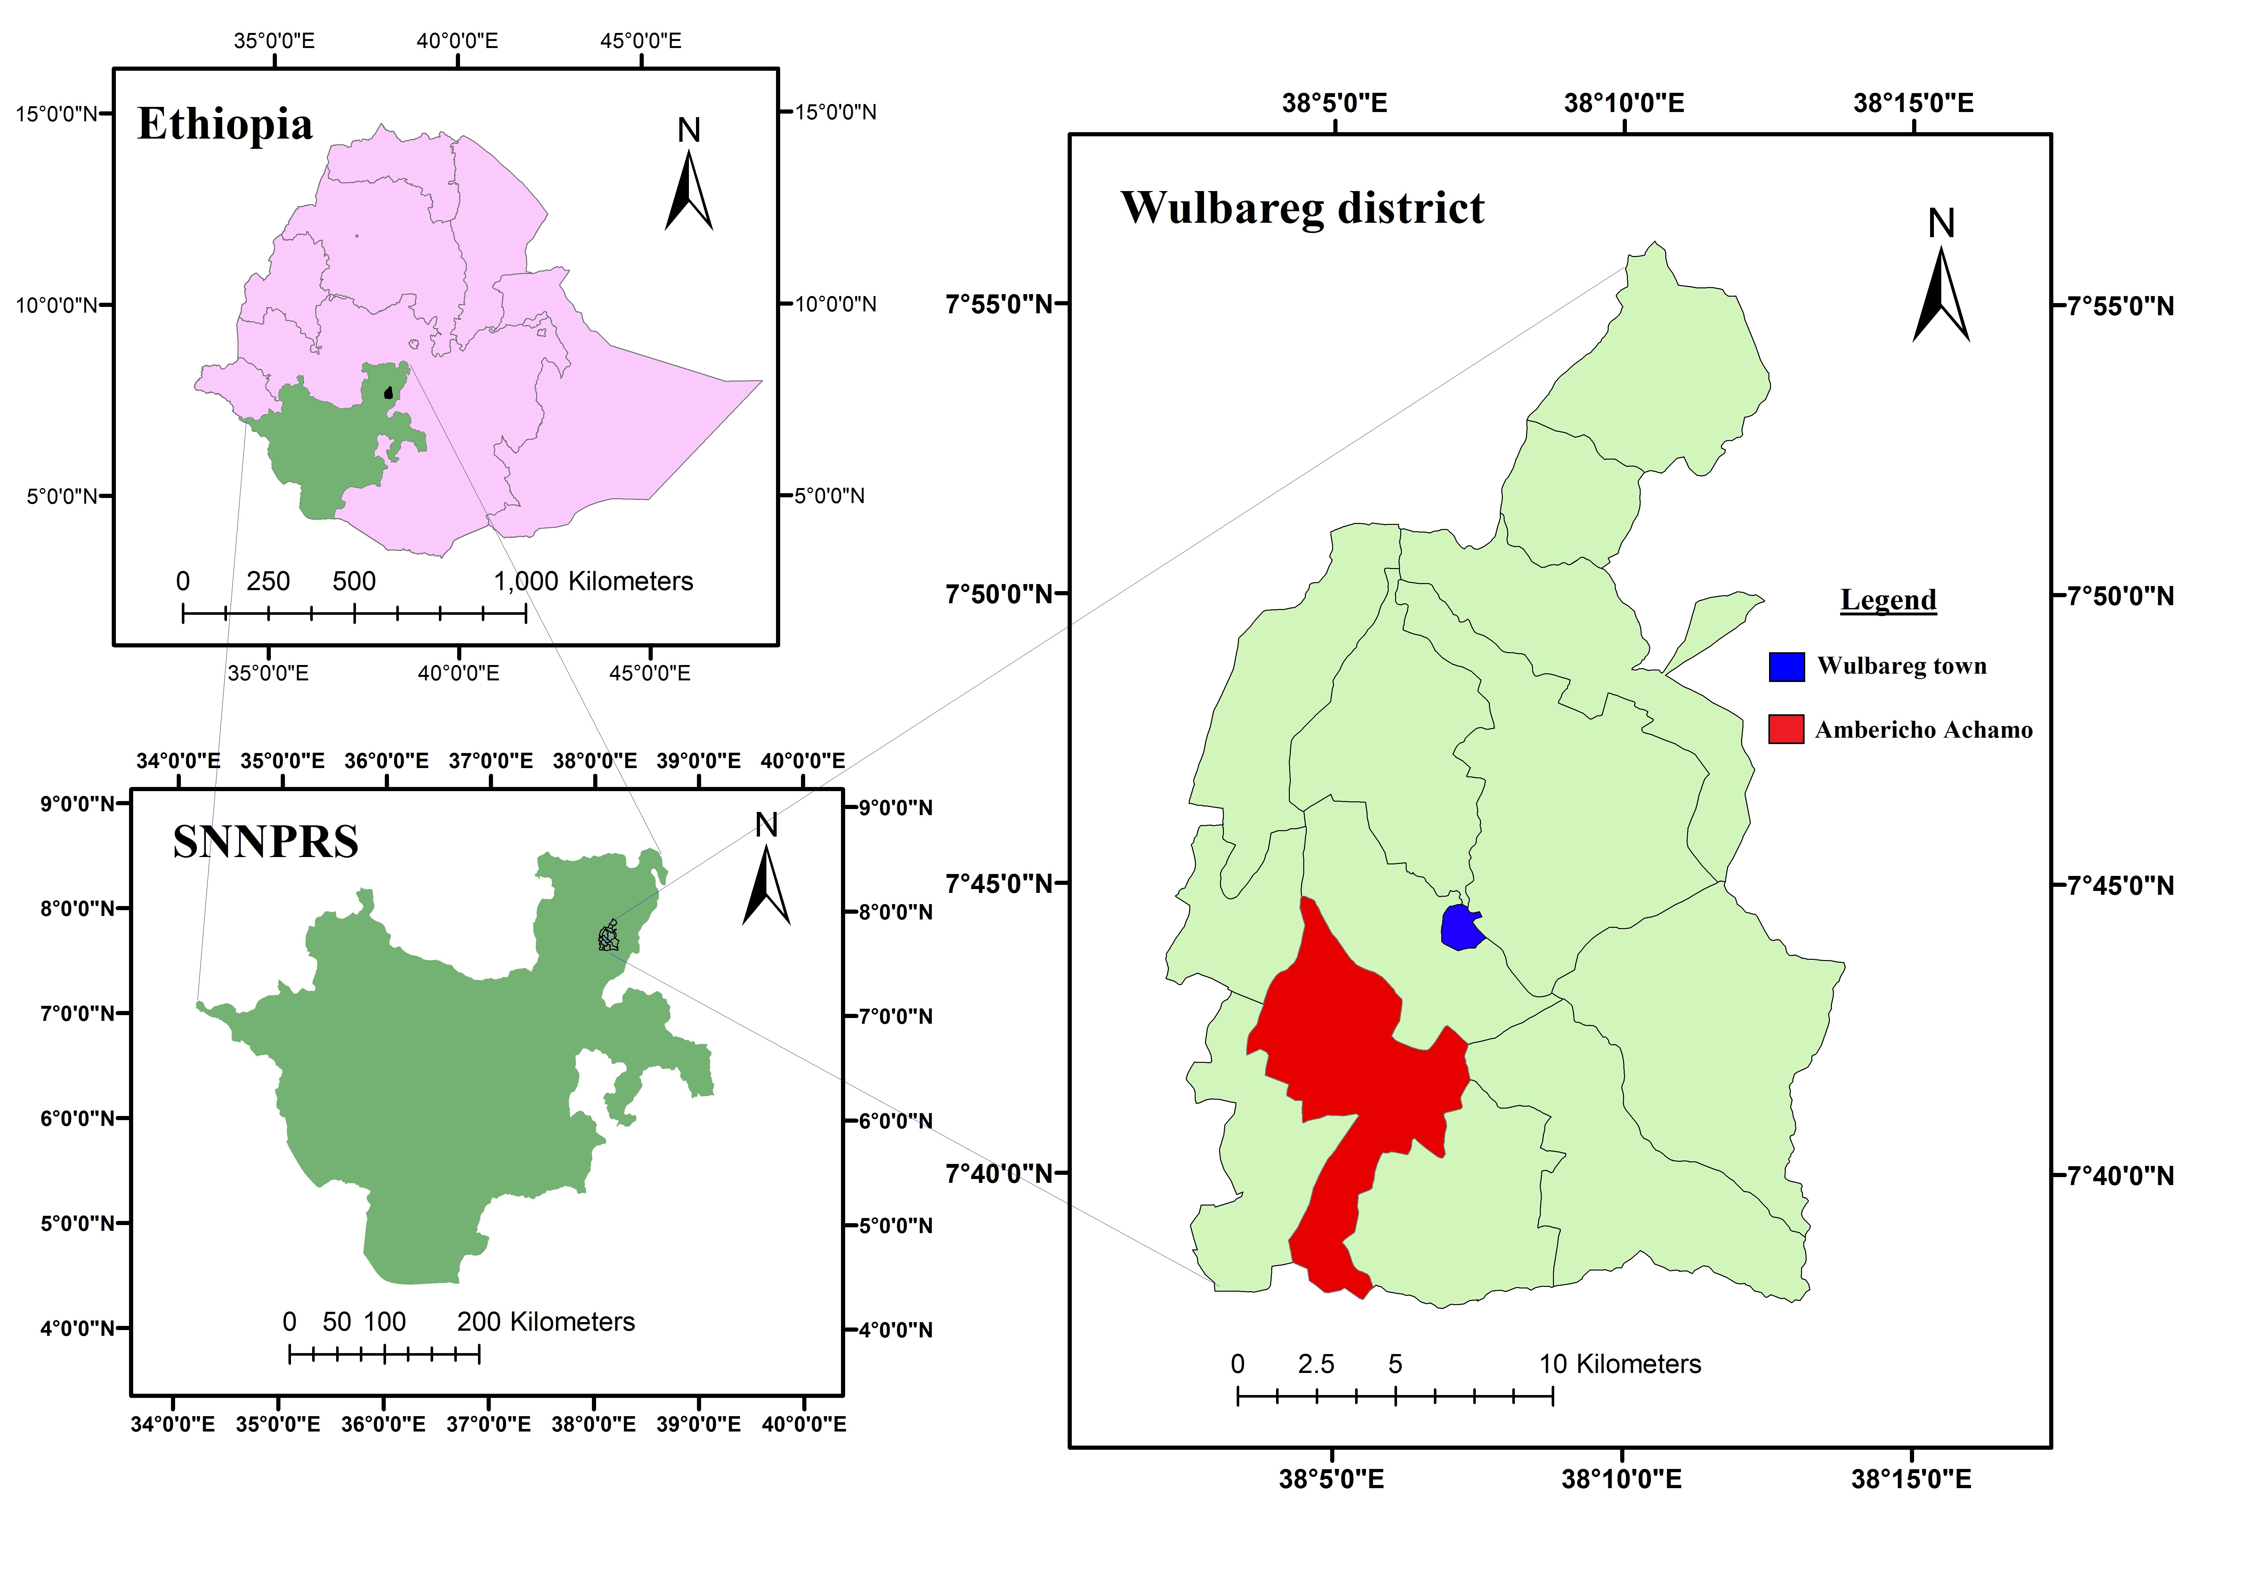
Socio-economic and Environmental Impacts of Community-Based Rehabilitation Programmes on Degraded lands: The case of Silte Zone, Southern Ethiopia
*Wondimagegn Amanuel¹, Fekadu Dule¹, Solomon Mulat¹
.
Introduction
Results
The major causes of land degradation in Ethiopia are the rapid population increase, severe soil loss, deforestation, low vegetative cover and unbalanced crop and livestock production [Badeg, 2011].
Exclosures (Area closures) are among various land management and rehabilitation strategies practiced to improve species diversity, soil quality and ecosystem productivity [Lal and Stewart, 1992].
The strategy has been instrumental to reclaim degraded lands in terms of cost, time of revival and the benefit it offers to the rural communities [Kindeya , 1997; Kidane , 2002].
Ecological and environmental benefits from area enclosure
Socioeconomic benefits from area enclosure
Conclusion
Objective
HH income enhanced because of the
enclosed area
9.2%
Households attitude towards income generation from the enclosed area
The results of the study revealed that community-based rehabilitation programs have significant economical, social and environmental impacts.
As a result, the majority of local communities have developed positive attitude towards such programs. Such perception is a base mark for future sustainability of the practice.
90.8%
☺5.8 😐47.1 ☹47.1
To investigate the social, economic and environmental impact s of rehabilitation programs. and the impact that the recovery has on the livelihoods of the rural communities
Change in households net-income due to different benefits generated from the enclosure
Employment prospect from
the enclosed area
81.1%
18.9%
High 43.3 %
Low 56.7 %
Recommendation
Materials and Methods
Fuelwood supply from the area enclosure
25.5 55.3 19.2
Area closure enhanced crop yield
✓ 87.2% ✗ 12.8%
Assisted and farmers’ managed natural regeneration are simple and effective restoration measures that require little investment.
Collaboration of scientists, local communities and stakeholders is a key factor for success of rehabilitation programs.
Careful selection, knowledge of silvicultural management, planting techniques and developing participatory and holistic bylaws will provide the fundamental basis to enhance the rehabilitation and productivity rate of enclosures
This study was conducted at Wulbareg district of SNNPR in Ambaricho Achamo kebelle.
Purposive sampling technique was used to select sample HHs (N= 100 ).
PRA tools (semi-structured questionnaire, KI interview, FGD and direct observation) were used for data collection. Secondary data sources were also assessed.
SPSS V.20.0 was used for data analysis.
Use of energy saving Now In future (Willingness
stove for cooking 9.3% 90.7% 97.1% 2.9%
Communities management interventions on enclosed area
(Pi- chart)
References
Bishaw, B. 2001. Deforestation and Land degradation in Ethiopian high lands: A strategy for physical recovery, North East African Studies, 8(1), 7-25
Kidane Giday 2002. Woody biomass estimation in community managed closure areas in Tigray: Implications to sustainable management and utilization. MSc Thesis, SLU, Sweden.
Kindeya G/Hiwot 1997. Area enclosures as an approach in the management of dry land biodiversity: a case study in Tigray Region, Northern Ethiopia. Proceedings of the workshop on management of dry land biodiversity. 30 July - 1 August, 1997, Nairobi, Kenya.

